Slide 1
Bank Term Deposit Subscription Classifier IE 7275 – Data Mining in Engineering
Group 15
Sanay Shah
Pushkar Dhabe

Slide 2
Table of Contents
Problem Setting………..
Problem Definition……
Data Source………………
Data Description……….
Data Pre-Processing….
Data Exploration……….
Visualization……………..
Data Mining Tasks……..
Model Exploration…….
Performance Evaluation
Performance Evaluation
Project Outcome……….
3
4
5
6
7
8
9
10
11
12
18
19

Slide 3
Problem Setting
Banks are required to make profits themselves so they can pay their employees and function systematically.
Banks use “Term-Deposits” (as one of many solutions) to facilitate their needs. This allows a bank to always know how much money they currently have which they can lend to other customers or make investments to turn profits.
Term deposits are extremely safe and are therefore appeal to low-risk investors who want to ensure security in their earnings.

Slide 4
Problem Definition
The data used belongs to a Portuguese banking institution.
Our aim is to build a classification model on the existing dataset to predict whether that customer will open a Term Deposit account in this bank or not.
The model could then be used to seek out potentially clients who would make the same investment.

Slide 5
Data Source
UCI Machine Learning Repository
https://archive.ics.uci.edu/ml/datasets/bank+marketing#

Slide 6
Data Description
The data contains about 40 thousand entries and has about 20 attributes. The attributes describe their clients. This data was collected from May 2008 to November 2010.
Key Attributes of this dataset –
- Age, Education, Job : Describes customer.
- Month, Day_Of_Week, Duration : Describes contact made with customer.
Target variable (y) – If the client subscribed to a term deposit (binary – yes or no).

Slide 7
Data Pre-Processing
A lot of “unknown” were replaced with NaNs.
These NaNs were mostly found in categorical attributes like Job, Marital, Education, Default, Housing and Loan.
An “age-group” was then created based on the customer’s age. The mode of every attribute with respect to it’s “age-group” was then imputed for the NaNs.
Only one row remained which contained NaN, this row was then removed.

Slide 8
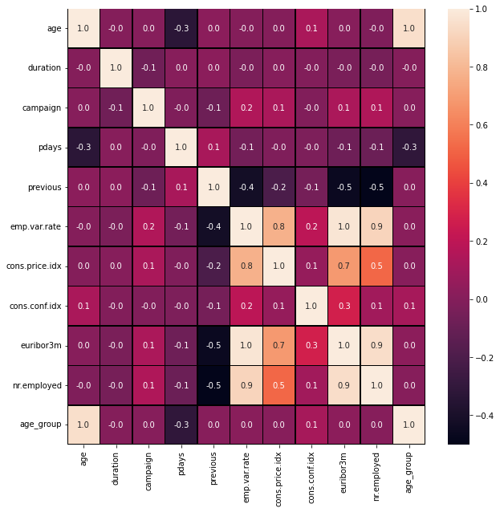
Data Exploration
It can be observed that euribor3m and nr employee are highly correlated. It’s the same case with nr employee and emp.var.rate.
Dropped column nr.employed as its highly correlated to two columns emp.var.rate and euribor3m.

Slide 9
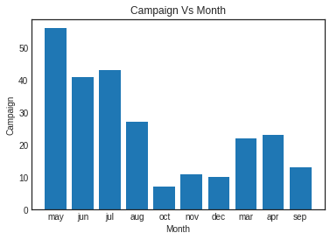
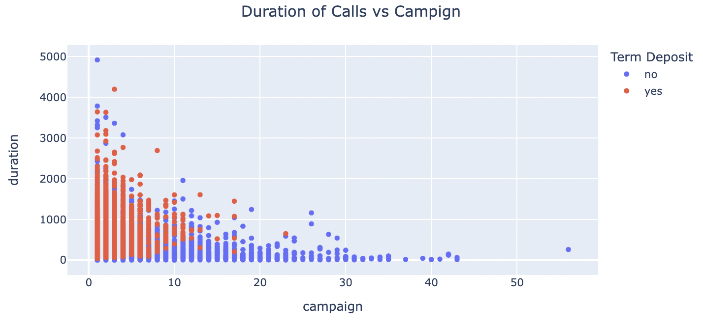
Visualization

Slide 10
Data Mining Tasks
Encoding - Month and Day of week
Ordinal Number Encoding -Loan, Housing
Ordinal One -Hot Encoding -Contact, Poutcome
Frequency Encoding -Job, Education
Encoding – Marital Status
Oversampled the data since the class of interest was a minority class

Slide 11
Model Exploration
We split the dataset into 80% training set and 20% test set.
Cross validation score was calculated on the training set with 5 folds.
The following models were used:
Logistic Regression
Gradient Boosting
KNN
Decision Tree
Random Forest
GridSearch was then used to tune the hyperparameters of the model based on accuracy to find the best model.

Slide 12
Performance Evaluation

Slide 13
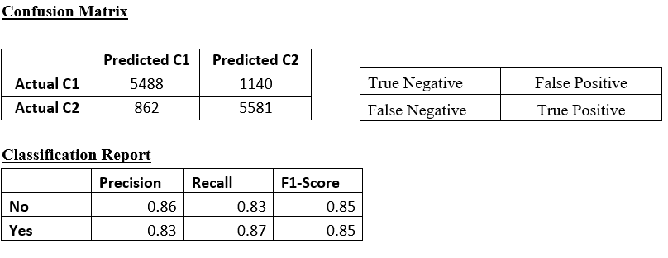
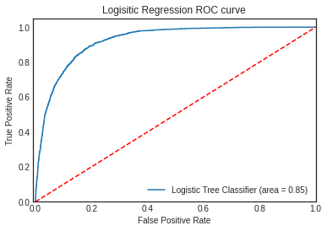
Logistic Regression
Train Accuracy : 84.3%
Test Accuracy : 84.83%

Slide 14
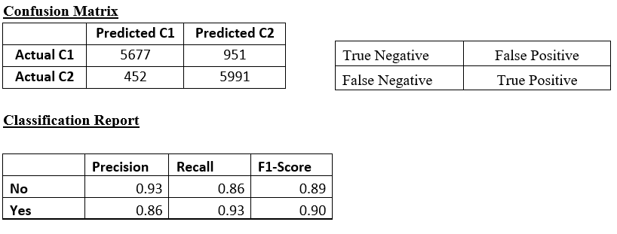
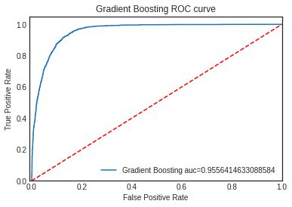
Gradient Boosting
Train Accuracy : 89.99%
Test Accuracy : 89.76%

Slide 15
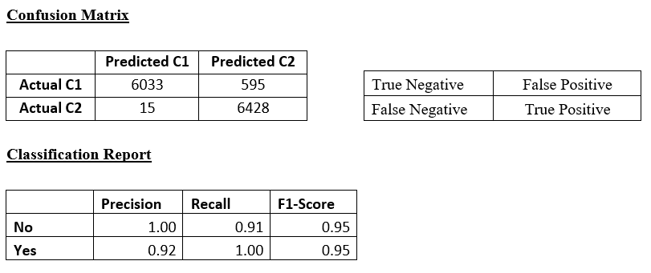
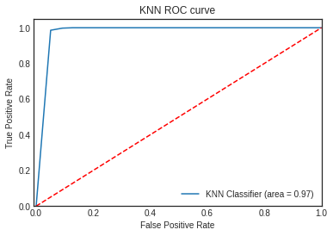
KNN
Train Accuracy : 97.33%
Test Accuracy : 95.5%

Slide 16
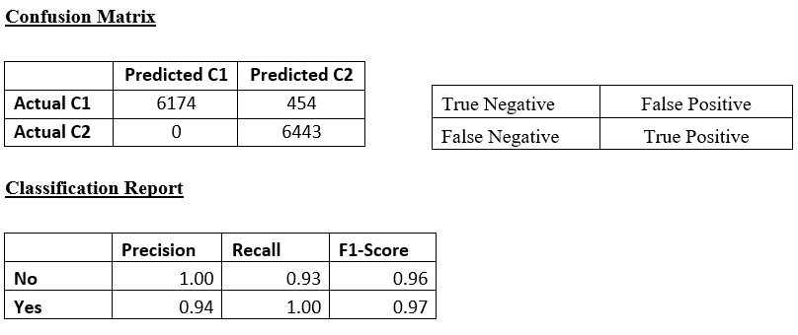
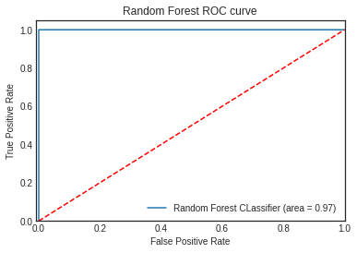
Random Forest
Train Accuracy : 98.06%
Test Accuracy : 96.53%

Slide 17
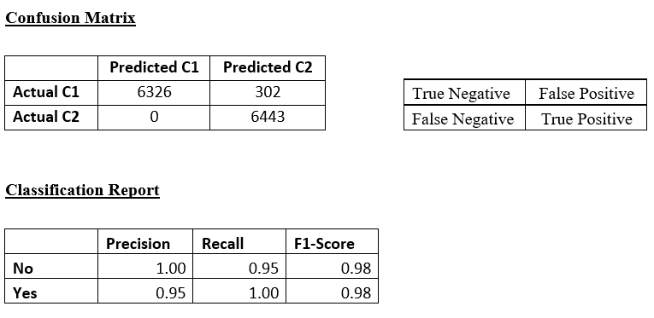
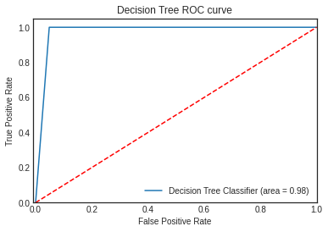
Decision Tree
Train Accuracy : 99.98%
Test Accuracy : 97.59%

Slide 18
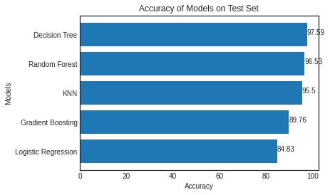
Final Model
Decision Tree is the best model.

Slide 19
Project Insights & Outcomes
Job roles should be classified according to corporate tiers, and all tier 1 employees should be contacted within a few days of the campaign starting.
Duration is a significant attribute in deciding the outcome of target Y.
Listen to the leads and get more information to provide the best deposit plan, which can lengthen the calls and lead to a deposit.
Approaching leads at the start of the new bank period (May-July) is a smart idea because many have showed favorable results in the past.
Tune the campaign according to national econometrics, and don't cut campaign spending when the national economy is struggling.

Slide 20
Thank You

